Slide 1

Course Code: MATH 211
Course Title: MATH III
Lecture 7
(Applications of Laplace Transforms to Differential Equations )
Tazin Tamanna
Lecturer in Mathematics
Department of Science and Humanities
M.Sc. in Applied Mathematics (KU)
B.Sc. in Mathematics (KU)

Slide 2
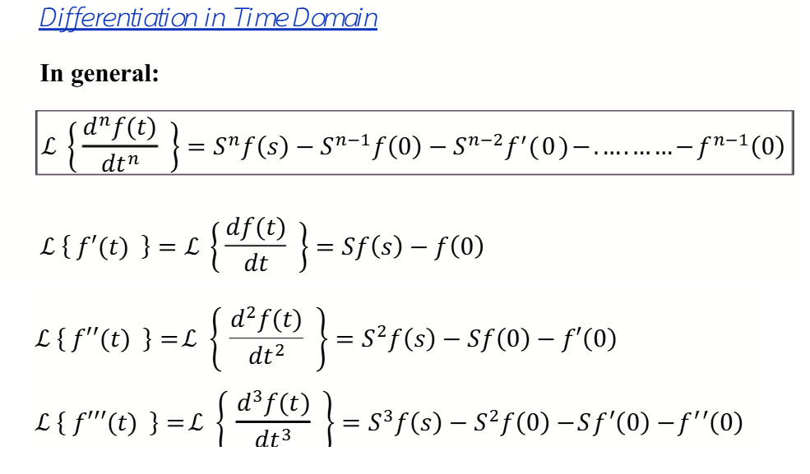

Slide 3
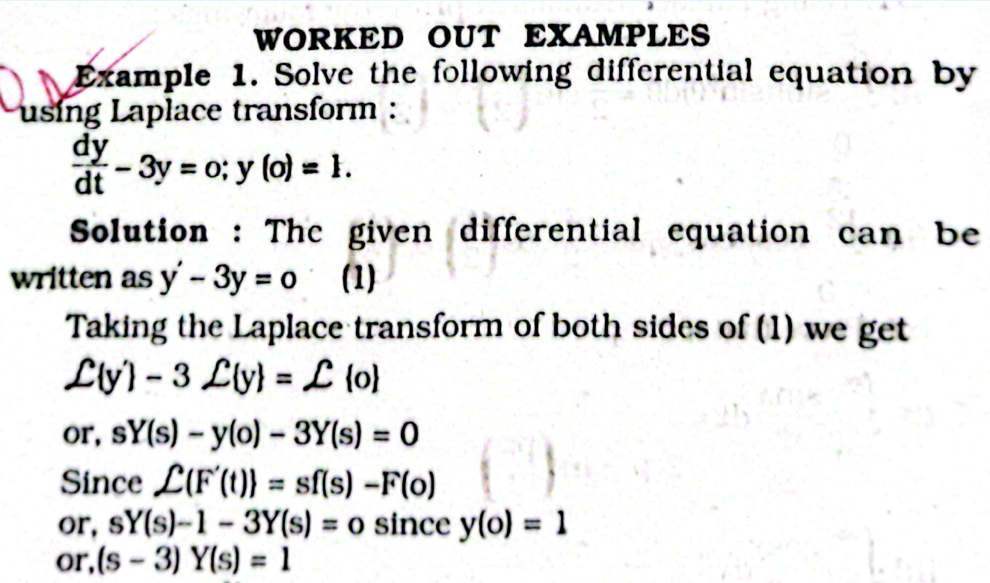

Slide 4



Slide 5
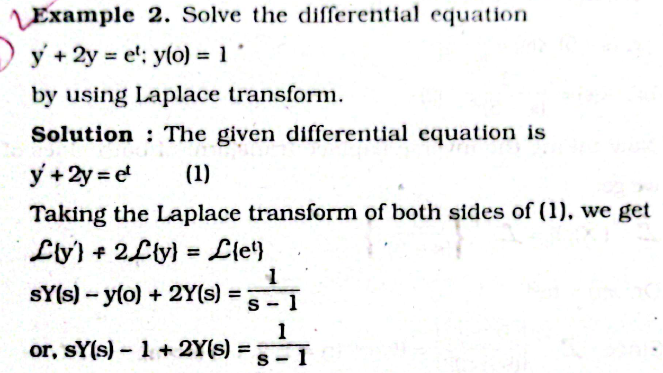

Slide 6
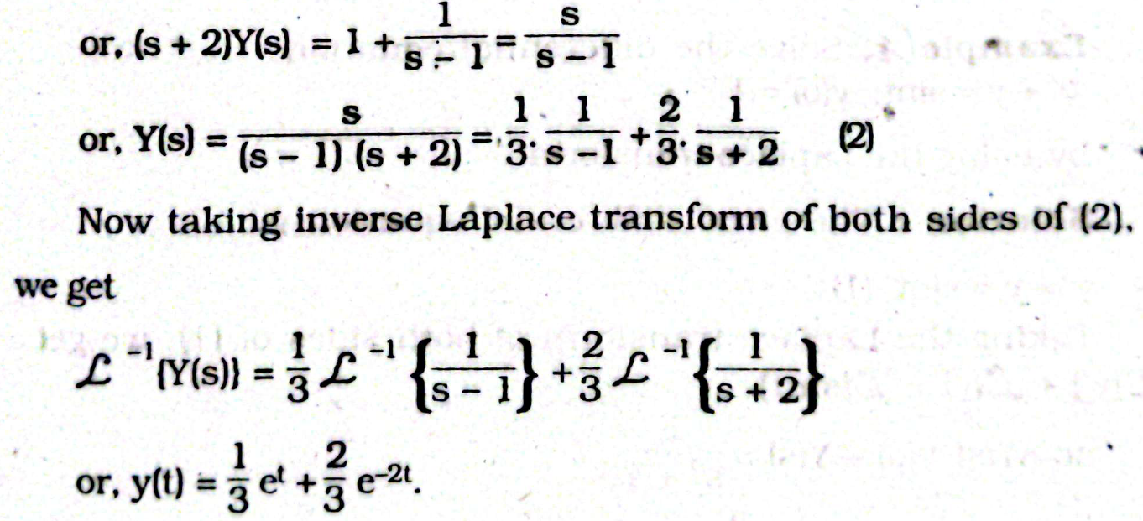

Slide 7

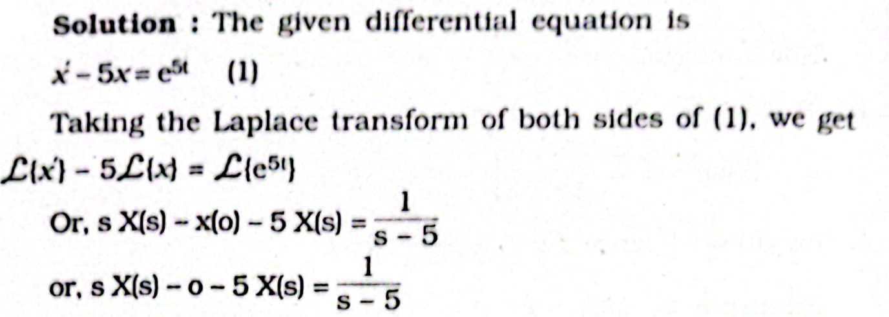

Slide 8
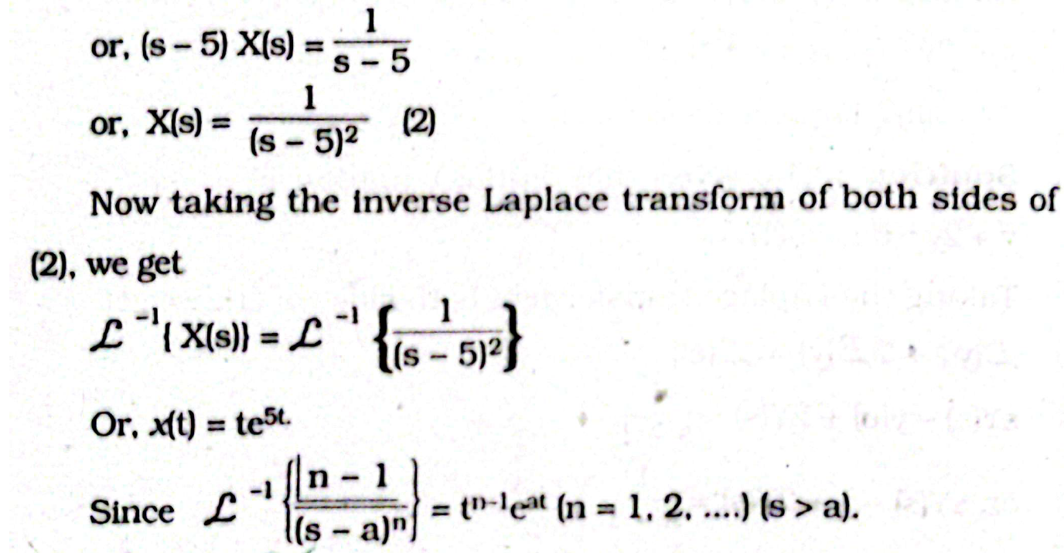

Slide 9
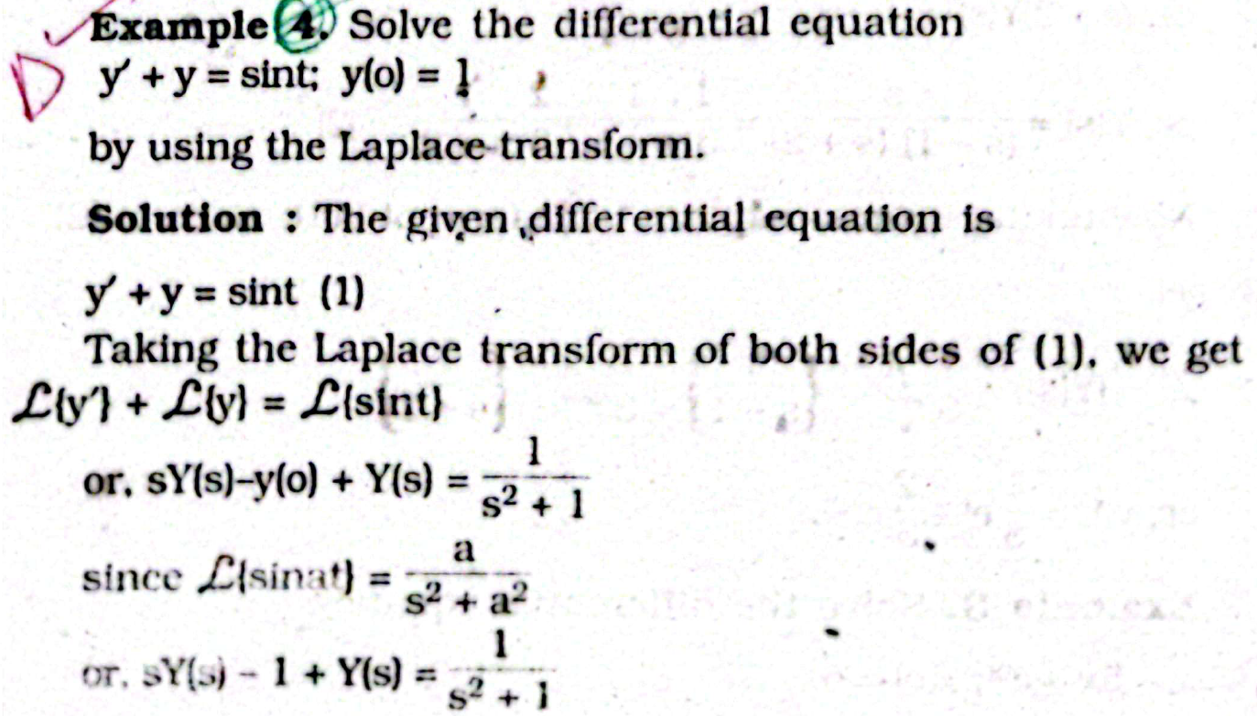

Slide 10
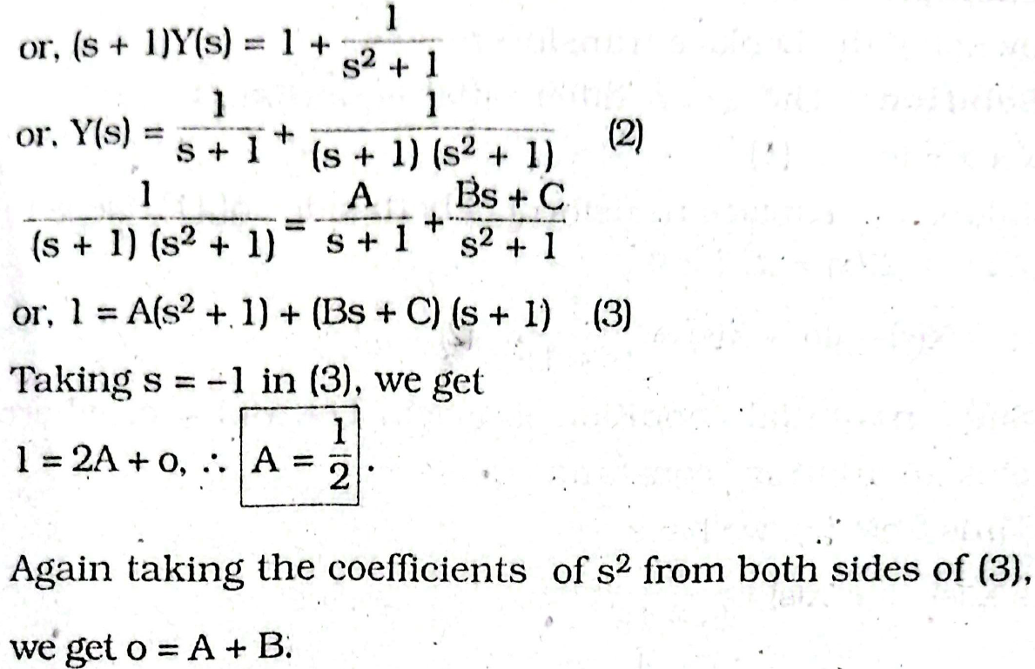

Slide 11
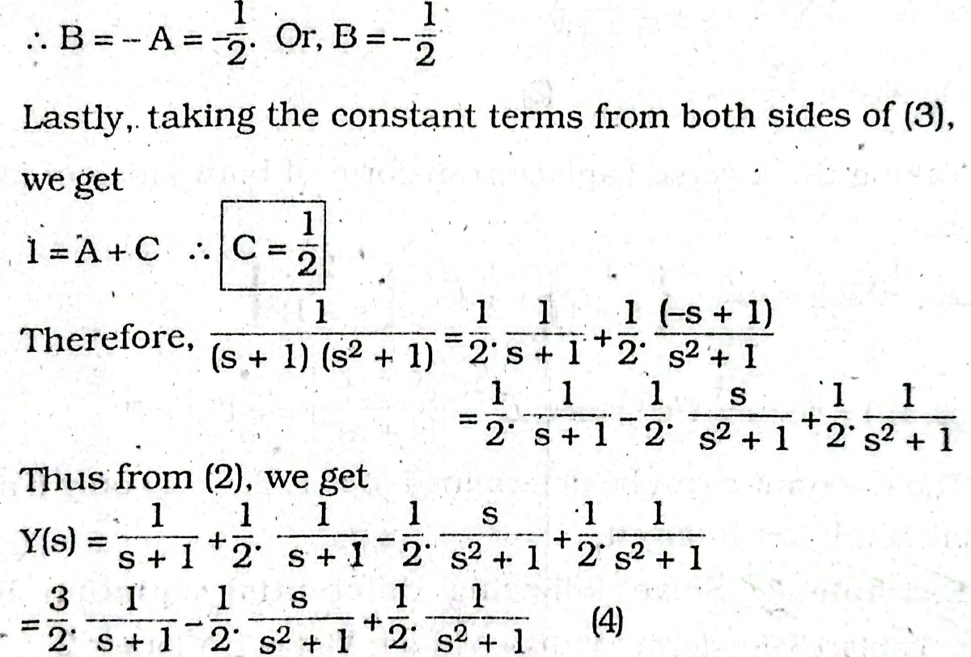

Slide 12


Slide 13
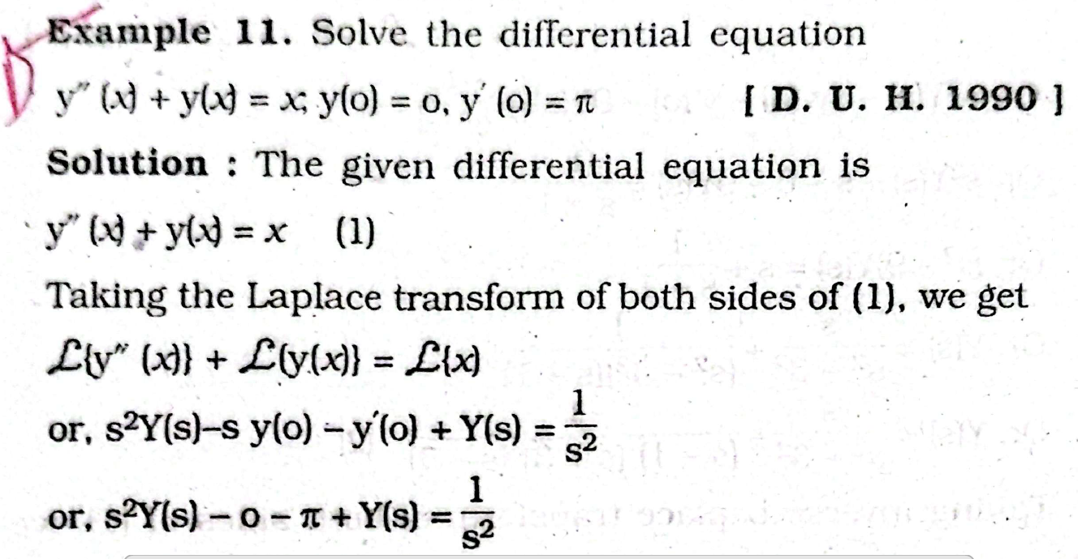

Slide 14
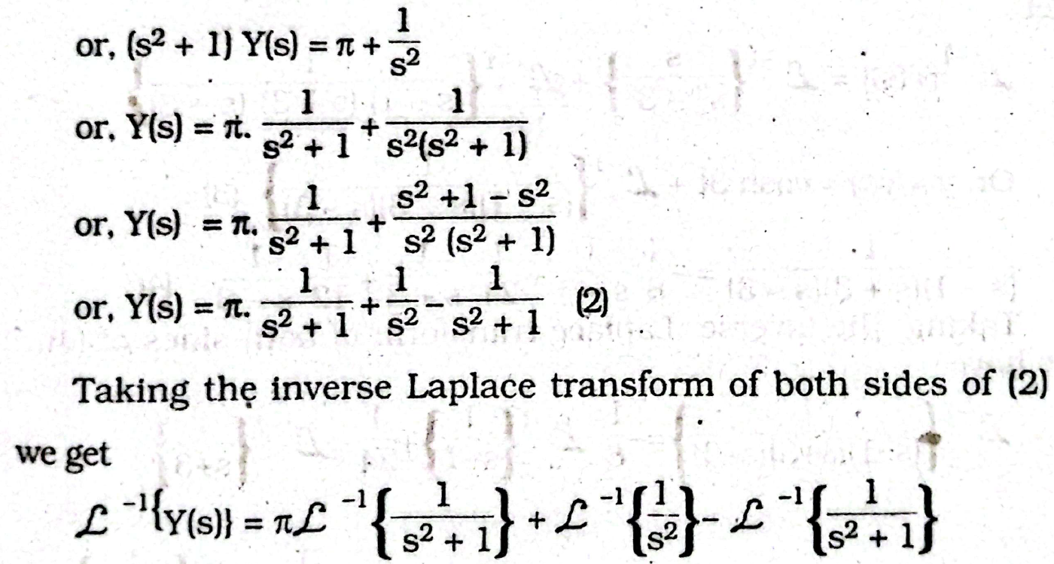

Slide 15

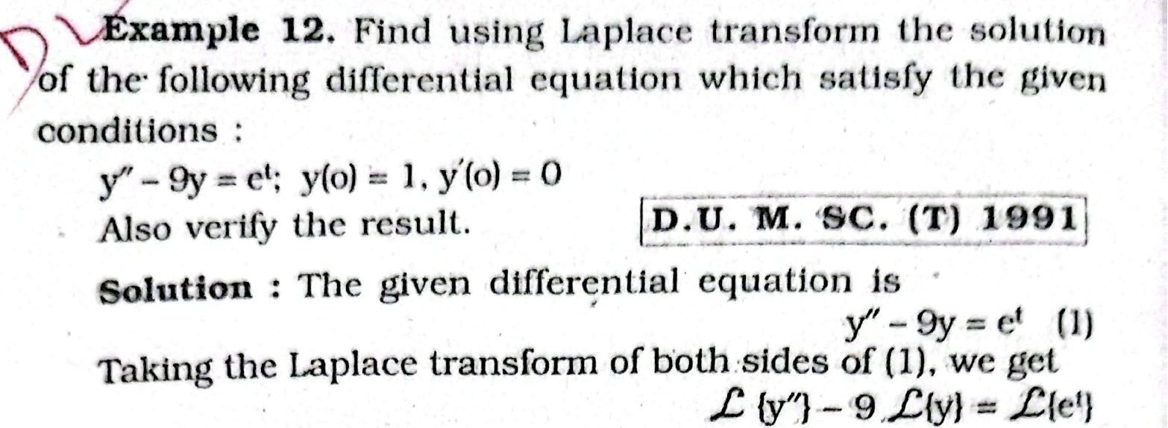

Slide 16
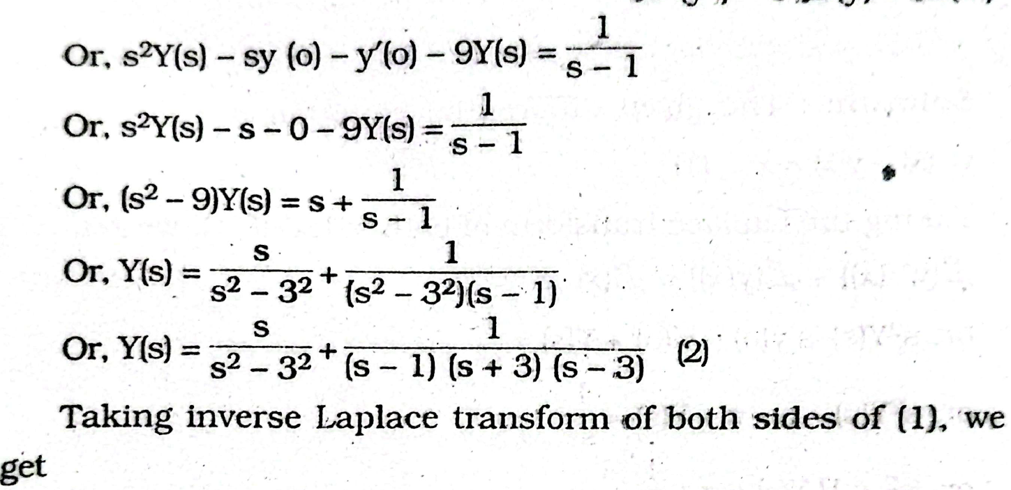

Slide 17
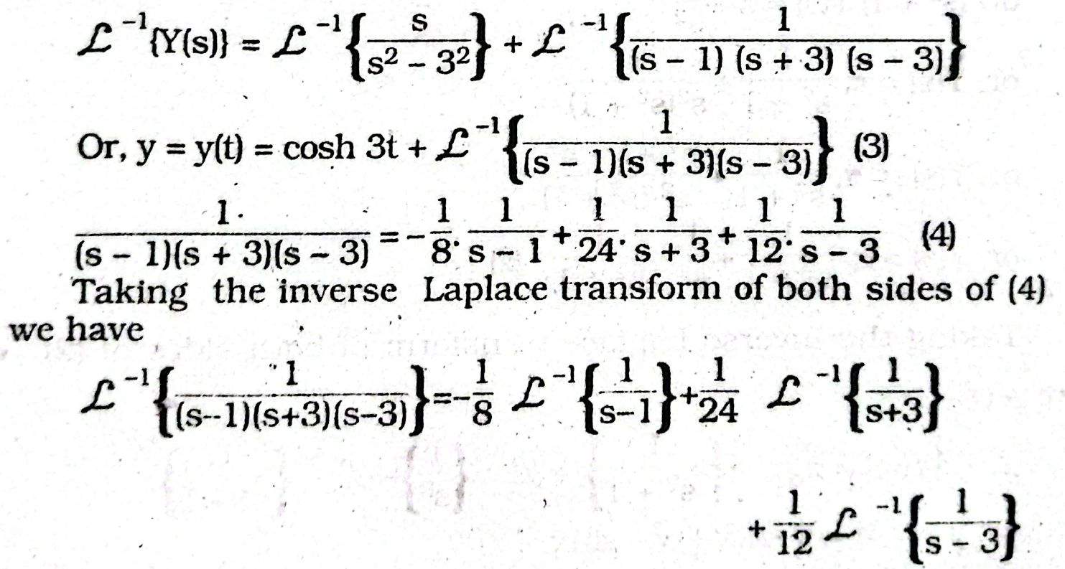

Slide 18



